Slide 1
COMP 3400
Week 6 - Friday

Slide 2
Last time
What did we talk about last time?
Networking

Slide 3
Questions?

Slide 4
Assignment 4

Slide 5
Exam 1 Post Mortem

Slide 6
Sockets

Slide 7
Sockets
The last class was a high-level overview of networking
Now, we'll look at how to turn those ideas into code
The most basic element of the networking arsenal is the socket
A socket is half of a tw0-way connection between hosts
We create a socket with a call to socket()
  Returns an int, essentially a file descriptor
  Is similar to calling open() on a file
  We can call read() and write() on socket file descriptors
int socket (int domain, int type, int protocol);

Slide 8
IP addresses
Computers on the Internet have addresses, not names
Google.com is actually 74.125.67.100
Google.com is called a domain
The Domain Name System or DNS turns the name into an address

Slide 9
IPv4
Old-style IP addresses are often written in this form:
  74.125.67.100
4 numbers between 0 and 255, separated by dots
That's a total of 256⁴ = 4,294,967,296 addresses
But there are 8 billion people on earth…

Slide 10
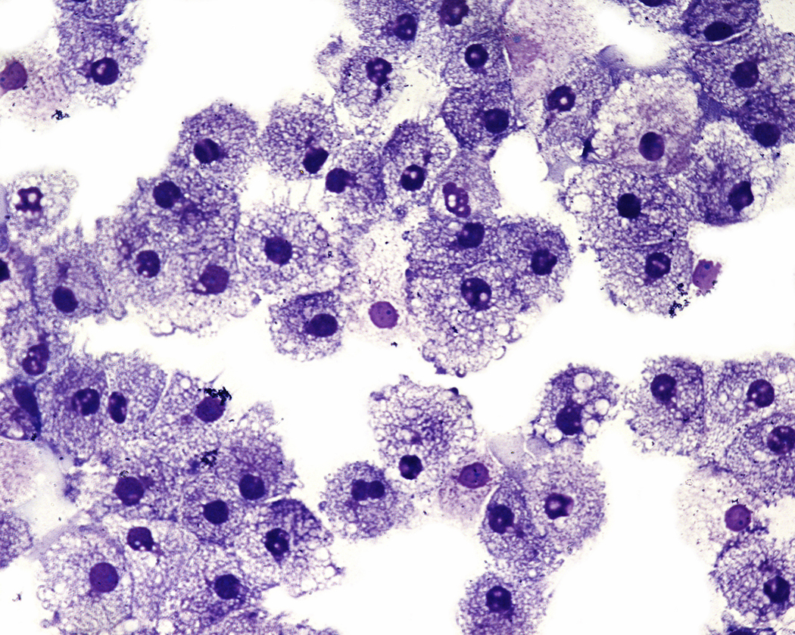
IPv6
IPv6 are the new IP addresses that are beginning to be used by modern hardware
  8 groups of 4 hexadecimal digits each
  2001:0db8:85a3:0000:0000:8a2e:0370:7334
  1 hexadecimal digit has 16 possibilities
  How many different addresses is this?
  16³² = 2¹²⁸ ≈ 3.4×10³⁸ is enough to have 500 trillion addresses for every cell of every person’s body on Earth
  Will it be enough?!

Slide 11
Details for socket()
int socket (int domain, int type, int protocol);
domain
  What the socket will be used for
  Typical values are IPv4, IPv6, or local communication
type
  Determines the transport layer
  Usually TCP or UDP for this class
protocol
  Usually not used and set to 0
  Can be used for special raw sockets used for packer sniffers
Field | Constant | Purpose
domain | AF_INET | IPv4 addresses
 | AF_INET6 | IPv6 addresses
 | AF_LOCAL | Unix domain socket for IPC
 | AF_NETLINK | Netlink socket for kernel messages
 | AF_PACKET | Raw socket type
type | SOCK_STREAM | Byte-stream communication, for TCP transport
 | SOCK_DGRAM | Fixed-size messages, for UDP transport
 | SOCK_RAW | Raw data that is not processed by transport layer
protocol | IPPROTO_RAW | IP datagrams without transport-layer processing
 | ETH_P_ALL | Ethernet frames without network-layer processing

Slide 12
Example calls to socket()
Purpose | Call
IPv4 socket for TCP | socketfd = socket (AF_INET, SOCK_STREAM, 0);
IPv6 socket for TCP | socketfd = socket (AF_INET6, SOCK_STREAM, 0);
IPv4 socket for UDP | socketfd = socket (AF_INET, SOCK_DGRAM, 0);
IPv6 socket for UDP | socketfd = socket (AF_INET6, SOCK_DGRAM, 0);
Raw socket for sniffing unprocessed Ethernet frames | socketfd = socket (AF_PACKET, SOCK_RAW, htons (ETH_P_ALL));

Slide 13
Networking data structures
Different data structures are needed to specify addresses depending on what kind of networking is being done
Since C doesn't have inheritance, structs with the same size are treated interchangeably and then cast to each other when appropriate
One of these is struct sockaddr, which is 16 bytes in size
// generic address structure
struct sockaddr {
sa_family_t sa_family; // two bytes: AF_INET, etc.
char sa_data[14];
};

Slide 14
IPv4 socket addresses
The structure for holding IPv4 addresses is identical in size to struct sockaddr
// IPv4 address structure
struct sockaddr_in {
sa_family_t sin_family;
in_port_t sin_port;
struct in_addr sin_addr;
char sin_zero[8];
};
struct in_addr {
in_addr_t s_addr; // in_addr_t is an alias for uint32_t
};
Type | struct sockaddr
Fields | sa_family |  | sa_data
Data | 02 | 00 | 00 | 50 | 5d | b8 | d8 | 22 | 00 | 00 | 00 | 00 | 00 | 00 | 00 | 00
Fields | sin_family |  | sin_port |  | sin_addr |  |  |  | sin_zero
Type | struct sockaddr_in

Slide 15
IPv6 socket addresses
IPv6 addresses are longer and consequently require bigger (and stranger looking) structs
// IPv6 address structure
struct sockaddr_in6 {
sa_family_t sin6_family;
in_port_t sin6_port;
uint32_t sin6_flowinfo;
struct in6_addr sin6_addr; // IPv6 addresses are 128-bit
uint32_t sin6_scope_id;
};
struct in6_addr {
union {
uint8_t __u6_addr8[16]; // aliased as s6_addr
uint16_t __u6_addr16[8]; // aliased as s6_addr16
uint32_t __u6_addr32[4]; // aliased as s6_addr32
} __u6_addr;
};

Slide 16
Good news and bad news
The good news is that you (usually) don't have to muck around in the parts of the structs that represent actual IP addresses
  These are bytes laid out in specific patterns
  Not user-friendly representations like 74.125.67.100
  Functions handle the translation for you
The bad news is that some values inside of these structs are sensitive to endianness
  Which byte is considered the most significant in a machine
  When networking, important data like ports and addresses are sent between machines with potentially different endianness

Slide 17
Endian conversion
Rather than try to keep straight what the endianness of our machine and the endianness of the network is, we use a family of functions:
  hton: host to network endianness
  ntoh: network to host endianness
  They come in l (long) versions (for 32-bit integers) or s (short) versions (for 16-bit integers)
uint32_t htonl (uint32_t hostlong); // 32-bit from host to network
uint16_t htons (uint16_t hostshort); // 16-bit from host to network
uint32_t ntohl (uint32_t netlong); // 32-bit from network to host
uint16_t ntohs (uint16_t netshort); // 16-bit from network to host

Slide 18
Getting addresses from a host name
DNS converts a host name to an IP address
The getaddrinfo() function lets us get a linked list of matching addresses
The only annoying bit is that we have to fill out a hints structure
A utility function freeaddrinfo() is provided to free the linked list structure when done with it
int getaddrinfo (const char *name, const char *service,
const struct addrinfo *hints, struct addrinfo **results)
void freeaddrinfo (struct addrinfo *info);

Slide 19
The addrinfo struct
The result of getaddrinfo() is stored into the pointer given by the last argument
struct addrinfo {
int ai_flags;
int ai_family;
int ai_socktype;
int ai_protocol;
socklen_t ai_addrlen;
char *ai_canonname;
struct sockaddr *ai_addr; // Pointer to address we need
struct addrinfo *ai_next; // Pointer to next addrinfo in linked list
};

Slide 20
Getting address example
struct addrinfo hints, *server_list = NULL, *server = NULL;
memset (&hints, 0, sizeof (hints));
hints.ai_family = AF_INET; // IPv4
hints.ai_socktype = SOCK_STREAM; // Byte-streams (TCP)
hints.ai_protocol = IPPROTO_TCP; // TCP
assert (getaddrinfo (hostname, "http", &hints, &server_list) == 0); // Get addresses
for (server = server_list; server != NULL; server = server->ai_next)
{
if (server->ai_family == AF_INET) // Only take IPv4
{
// Cast to IPv4 socket
struct sockaddr_in *addr = (struct sockaddr_in *)server->ai_addr;
printf ("IPv4 address: %s\n", inet_ntoa (addr->sin_addr));
}
}
freeaddrinfo (server_list);

Slide 21
Confusing structs!
Here's a visualization of the addrinfo and sockaddr structs that might come back from getaddrinfo()
struct addrinfo
ai_flags | …
ai_family | AF_INET
ai_socktype | SOCK_STREAM
ai_protocol | IPPROTO_TCP
ai_addrlen | 4
ai_canonname | …
ai_addr
ai_next
struct addrinfo
ai_flags | …
ai_family | AF_INET6
ai_socktype | SOCK_STREAM
ai_protocol | IPPROTO_TCP
ai_addrlen | 16
ai_canonname | …
ai_addr
ai_next | NULL
struct sockaddr_in6
sin6_family | AF_INET6
sin6_port | 80
sin6_flowinfo | …
sin6_addr | 2606:2800:220:1: 248:1893:25C8:1946
sin6_scope_id | …
struct sockaddr_in
sin_family | AF_INET
sin_port | 80
sin_addr | 93.184.216.34
sin_zero | 0

Slide 22
Programming practice
Adapt the code on the previous slide:
  Read a host or IP address from the user
  Read a service or port name from the user
  Print out the resulting IP addresses
Note the following common port names and services:
Port | Name | Service |  | Port | Name | Service
21 | FTP | Insecure file transfer |  | 110 | POP3 | POP email access
22 | SSH | Secure shell |  | 123 | NTP | Time synchronization
23 | Telnet | Insecure remote access |  | 143 | IMAP | IMAP email access
25 | SMTP | Email delivery |  | 194 | IRC | Internet chat service
53 | DNS | IP address lookup |  | 389 | LDAP | Authentication
67 | DHCP | IP address assignment |  | 443 | HTTPS | Secure web page
68 | DHCP | IP address assignment |  | 530 | RPC | Remote procedure call
80 | HTTP | Web page |  | 631 | IPP | Internet printing
88 | Kerberos | Authentication |  | 993 | IMAPS | Secure IMAP access

Slide 23
Ticket Out the Door

Slide 24
Upcoming

Slide 25
Next time…
TCP socket programming

Slide 26
Reminders
Work on Assignment 4
  Due next Monday
Start on Project 2!
Read section 4.5

